Slide 1

Movie Recommendation System: A Business Approach
By
Roland Villafuerte

Slide 2

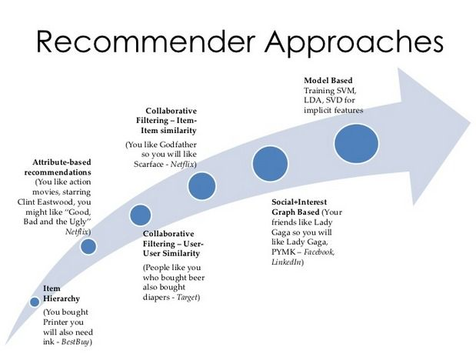
What is It?
Information
People
Items
Consume

Slide 3

Who Cares?

Slide 4

Revenue
Subscriptions
Ads
Control of items

Slide 5

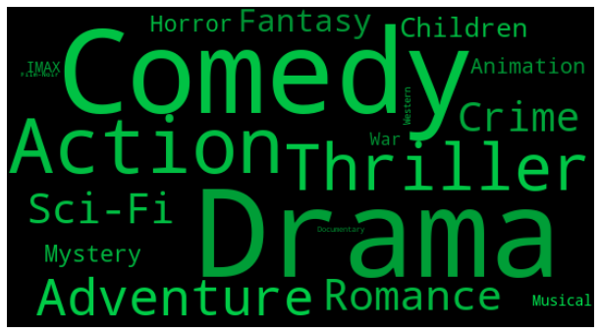
MovieLens
100k Ratings
600 Users
9,700 Movies

Slide 6

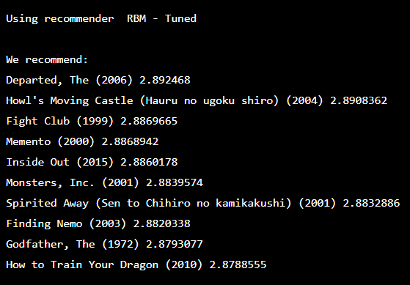
Top “N” Recommender
Most Common
Items on List
Rank Importance

Slide 7

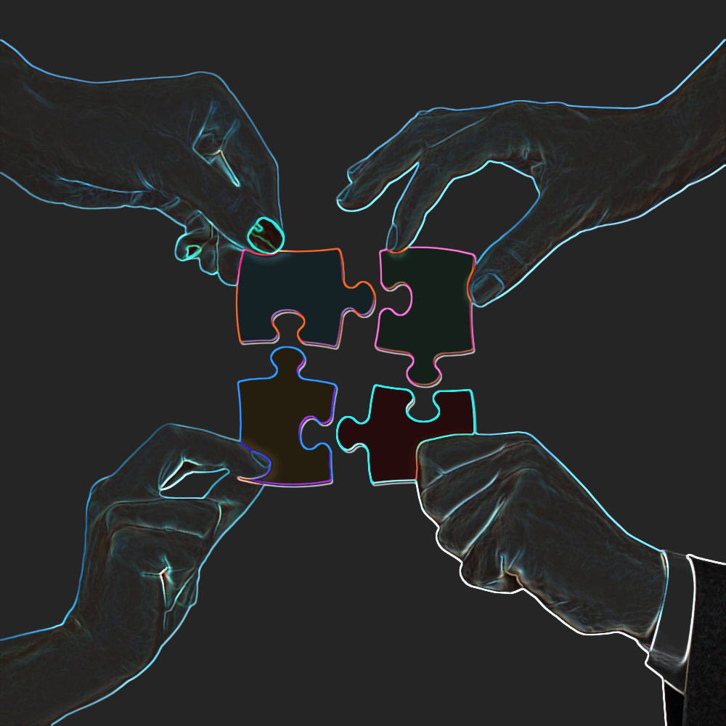
Metrics
2 for accuracy
3 user-focused
3 systemic

Slide 8

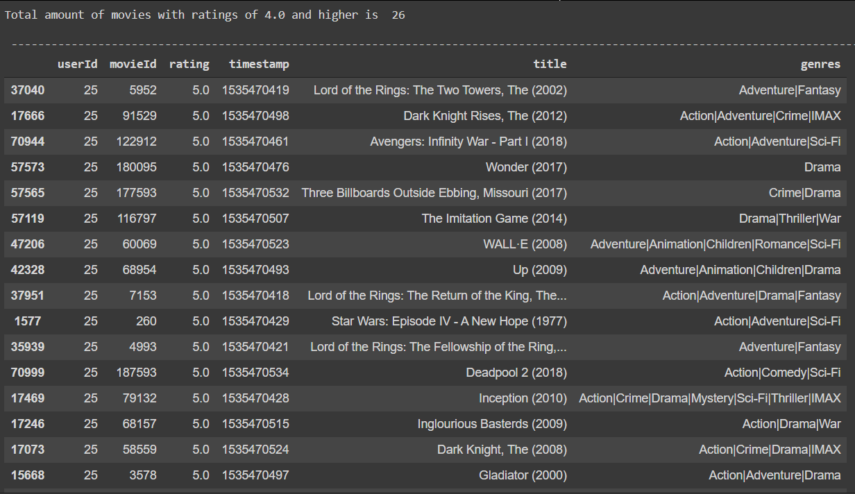
Qualitative

Slide 9
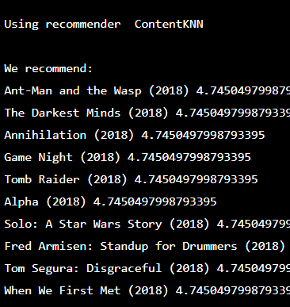
Content
Like items
Genre / Year
“Popular”

Slide 10
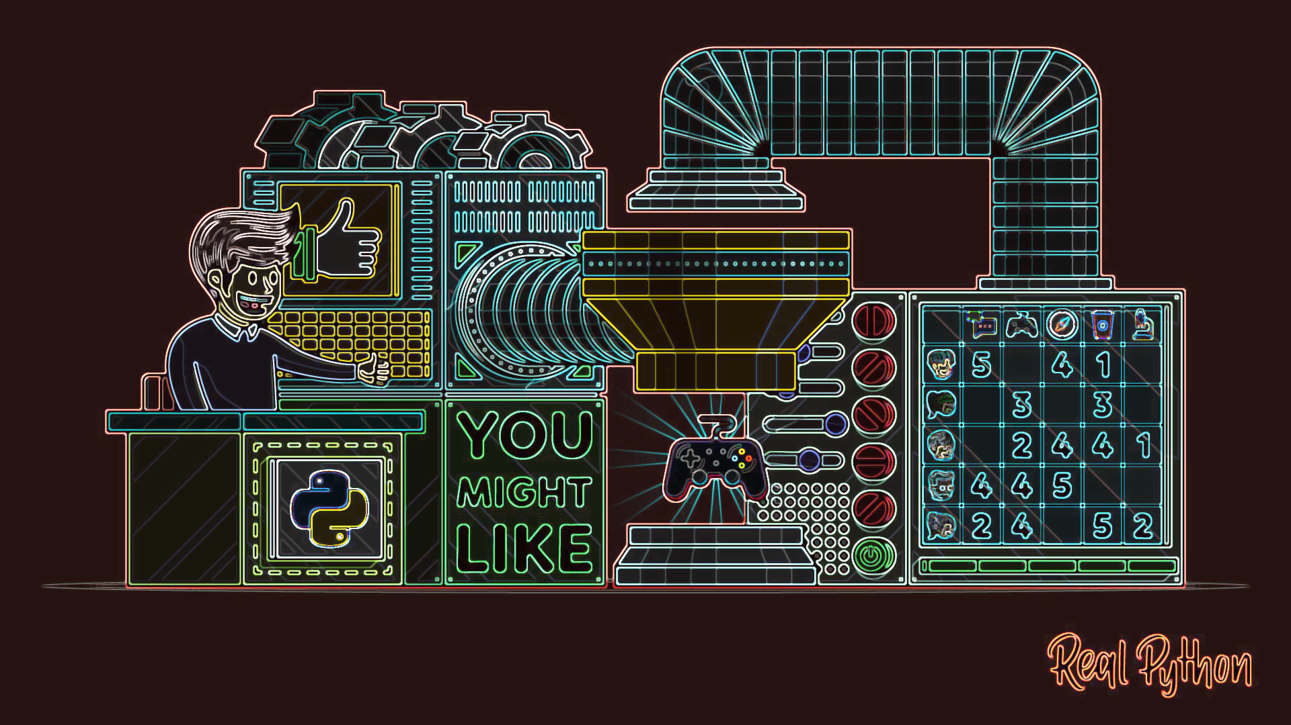
Machine Learning

Slide 11
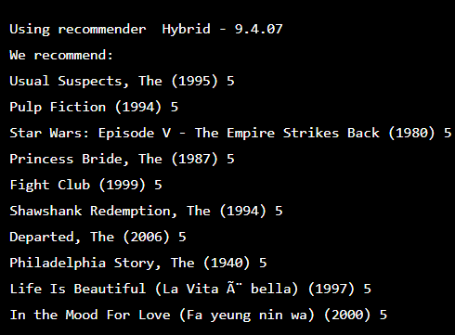
Machine Learning
User-Items
Hidden Patterns
Proven Technique
“Watch History”

Slide 12
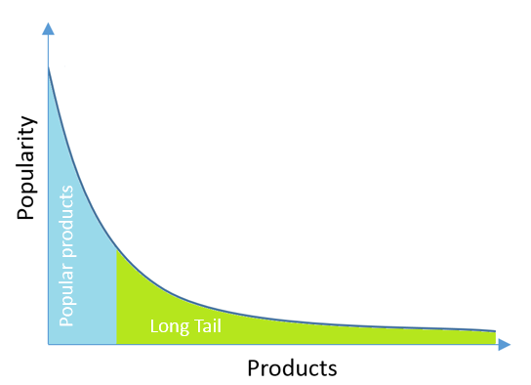
Long Tail
Random
80/20 Rule
Niche

Slide 13

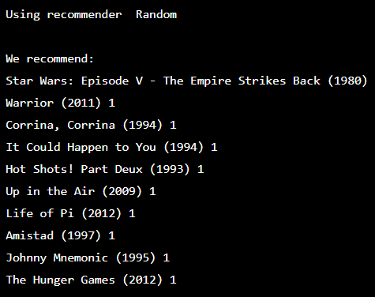

Random

Slide 14


Conclusion
Proven
Content
Business

Slide 15

Thank you!
Questions?

